Slide 1
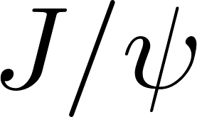
TMD Production in NRQCD
Marston Copeland, Reed Hodges, Thomas Mehen, Sean Fleming

Slide 2
Parton Model
In hadrons, the strong dynamics of QCD take place at the scale ~ 200 MeV.
Perturbation theory is not applicable, so other strategies to predict observables are necessary.
The parton model embeds the non-perturbative behavior in parton distribution functions (PDFs) and fragmentation functions (FFs).
In QCD, partons are identified with the quarks, antiquarks, and gluons inside of hadrons.

Slide 3
QCD Factorization
The parton model allows for “factorization” of cross sections.
. Separate physics taking place at different scales.
(a) Process independent non-perturbative contributions given by PDFs and FFs.
(b) Perturbatively calculable short-distance partonic cross sections ( ).
(a) can be extracted from experimental data, calculated on the lattice, or computed using effective field theories.

Slide 4
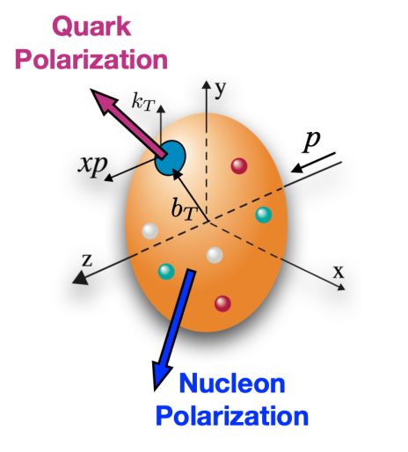
TMDs
Transverse Momentum Dependent (TMD) PDFs and FFs probe the 3D structure of hadrons.
TMDs are distribution densities to find a quark or a gluon carrying longitudinal momentum fraction (z) and transverse momentum ( ).
They provide correlations between hadron spin and parton polarization, in addition to the motion of the parton.

Slide 5
SIDIS
Semi-Inclusive Deep Inelastic Scattering (SIDIS) will be a major focus of the upcoming Electron-Ion Collider.
Electron is scattered off a proton and produced hadrons are detected in the final state!

Slide 6
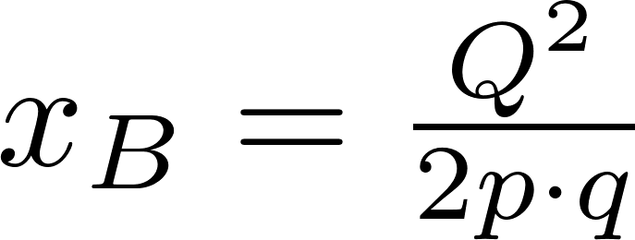
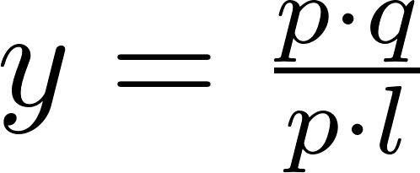
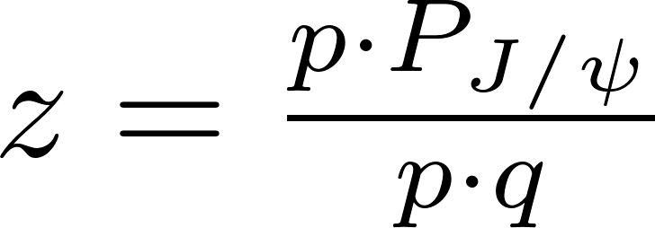
Kinematics
Process can be written in terms of standard DIS variables.

Slide 7
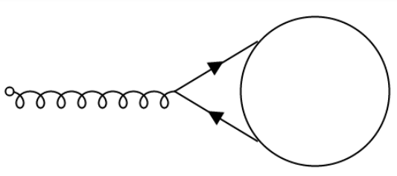
Why Production?
The large masses the heavy quarks allow for the non-perturbative dynamics to be studied using Non-Relativistic QCD (NRQCD).
Something we can actually calculate!
hadronization can be identified with the production of a .
Non-perturbative effects happen at longer distances.
Offers one of the few direct probes of the gluon content in the proton

Slide 8
NRQCD
Non-Relativistic QCD is an effective field theory of QCD where heavy quarks are treated as non-relativistic, but gluons and light-quarks are left as the fully relativistic fields.
Can be derived by making a non-relativistic expansion of the spinors.
High-order relativistic effects can be incorporated systematically.

Slide 9
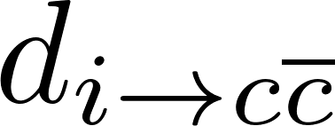
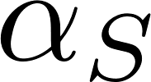
NRQCD (cont’d)
NRQCD factorization conjecture separates quarkonium TMDFF into short distance coefficients ( ) and NRQCD long distance matrix elements ( ).
Short distance coefficients are perturbatively calculable though NRQCD matching.
Calculation involves a double expansion in and in relative velocity of pair ( ).

Slide 10
Production Mechanisms
In SIDIS there are two ways to produce a at leading order.
The incoming electron can strike a quark which then fragments into a .
Or the electron can “strike” a gluon – the emitted virtual photon fuses with the gluon to create a pair.
The latter is a probe of gluon structure at leading twist!

Slide 11
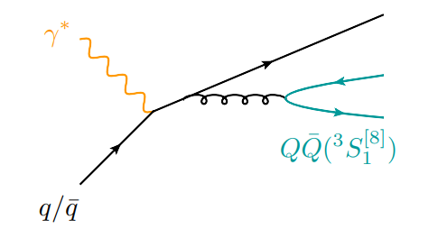
Fragmentation Functions
Fragmentation functions tell us the probability that a parton “i” will hadronize into a hadron “H”.
Provide information on how hadrons emerge from energetic quarks and gluons.
Like PDFs, defined by non-perturbative matrix elements and are used in factorization theorems.

Slide 12
Quark Fragmentation to
Production of a pair fragmenting from a light quark gives 3 possible diagrams (plus mirrors) at lowest order.
Only unpolarized quark to unpolarized TMD FF has been studied before.

Slide 13
Some Details of Calculation

Slide 14
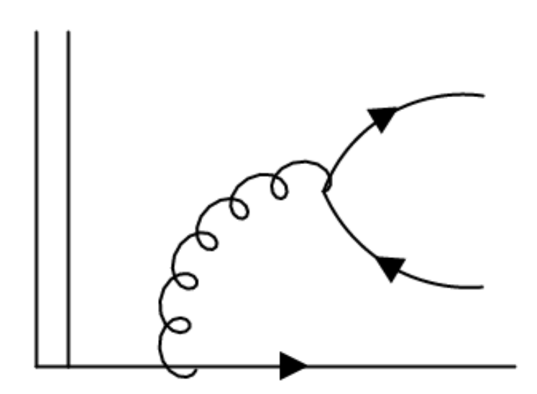
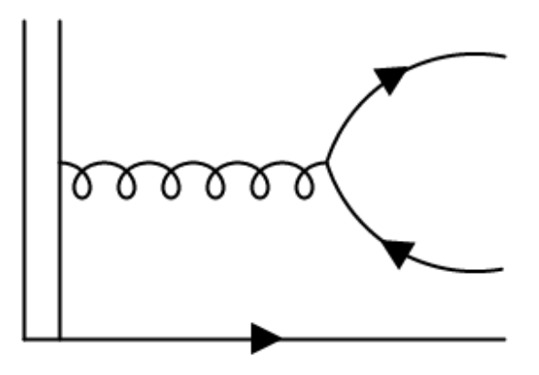
Some Details of Calculation

Slide 15
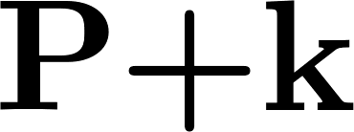
Some Details of Calculation

Slide 16
Some Details of Calculation
Optical Theorem
Gluon off-shell

Slide 17
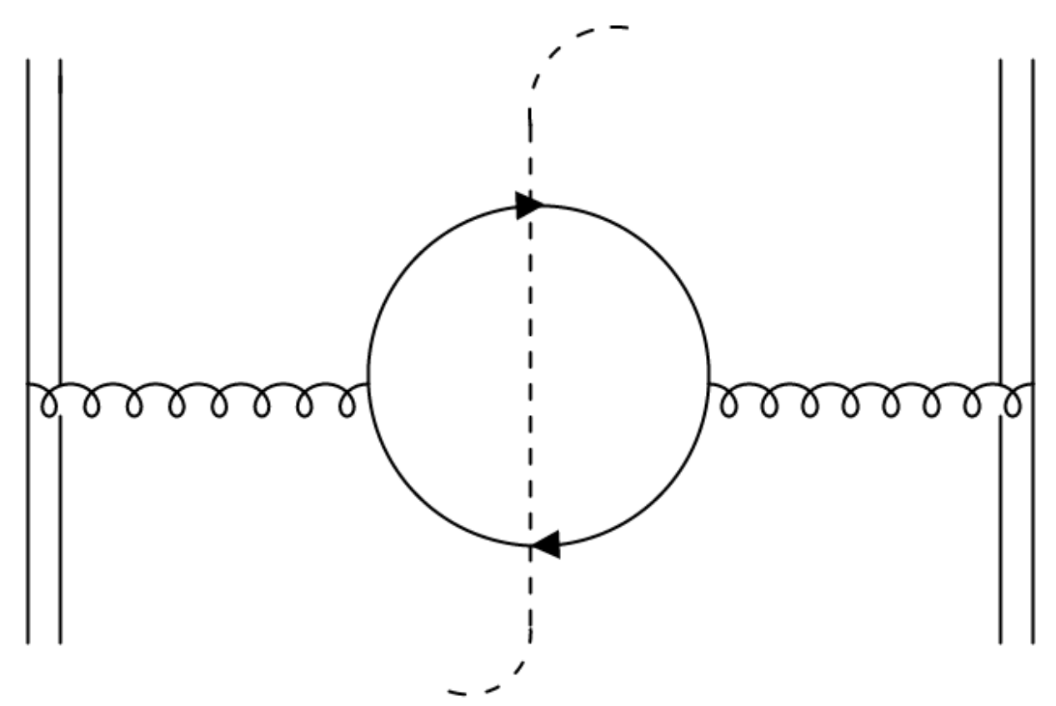
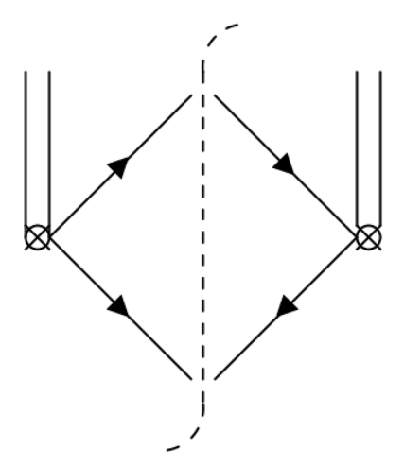
NRQCD Matching
Also need to calculate matrix elements in NRQCD theory, then match to pQCD results.
Theories have same low energy behavior!
Infrared poles between the two theories must agree.

Slide 18
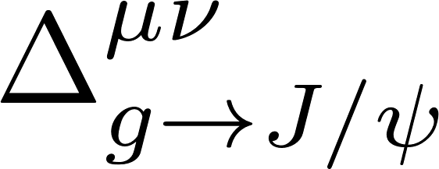
Matching example

Slide 19
Matching example

Slide 20
Matching example

Slide 21
Matching example
So

Slide 22
Matching example
So

Slide 23
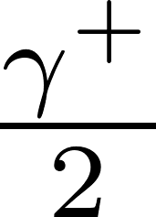
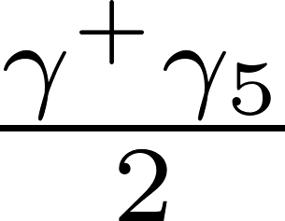
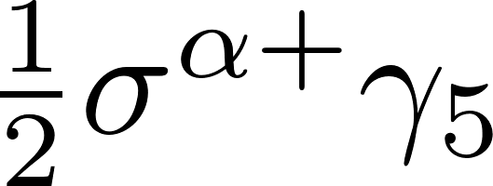
Quark to Polarizations
Quark can be unpolarized ( ), longitudinally polarized ( ), or and transversely polarized ( ).
Project out these states by completing spin trace in definition.
Project out polarization by replacing polarization vectors (like tensor decomposition).

Slide 24
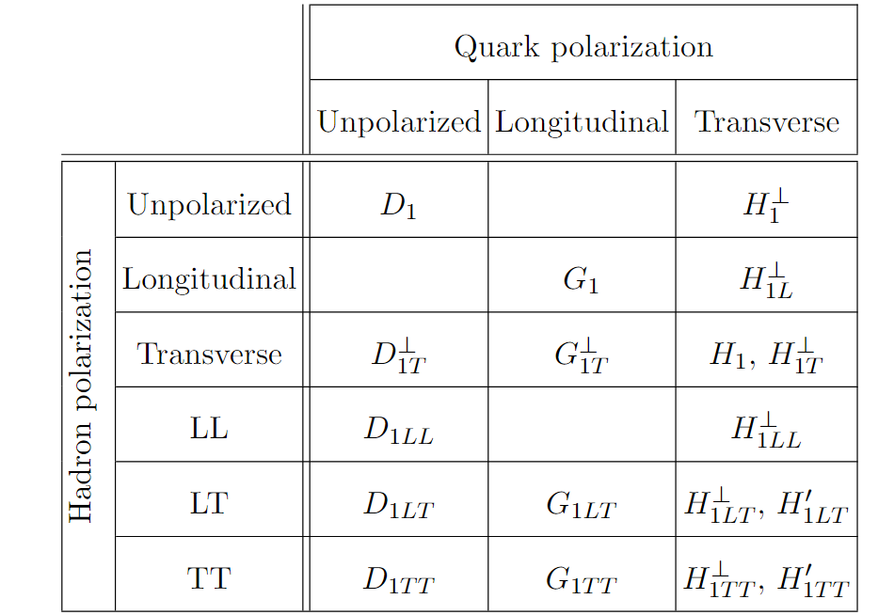
Quark to Polarizations
can be unpolarized, vector polarized (longitudinal or transverse), or tensor polarized (LL, LT, or TT).
There are 18 polarized quark to TMD fragmentation functions.

Slide 25
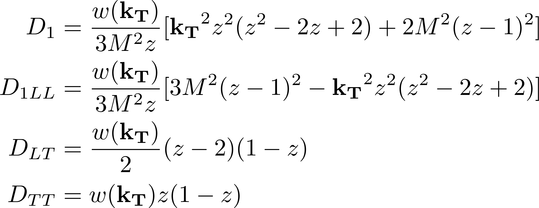
Quark Fragmentation Functions
At leading order in the strong coupling, only seven FFs survive!
Unpolarized quark:

Slide 26
Quark Fragmentation Functions
At leading order in the strong coupling, only seven FFs survive!
Unpolarized quark:

Slide 27
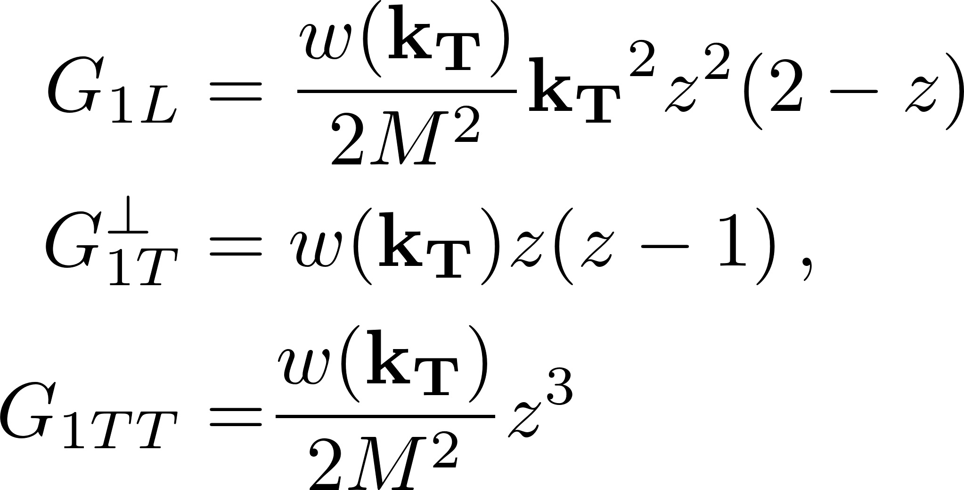
Quark Fragmentation Functions
Longitudinally polarized quark:

Slide 28
Quark SIDIS Cross Sections
With unpolarized and unpolarized parton, there is only one contribution to the cross section at leading twist.
where

Slide 29
Polarized SIDIS cross section
Polarized production is a much richer test of QCD!

Slide 30
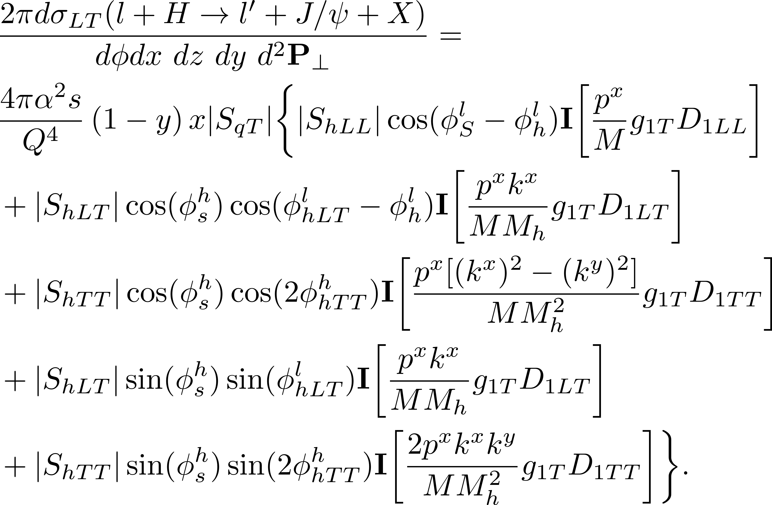
Polarized SIDIS cross sections

Slide 31
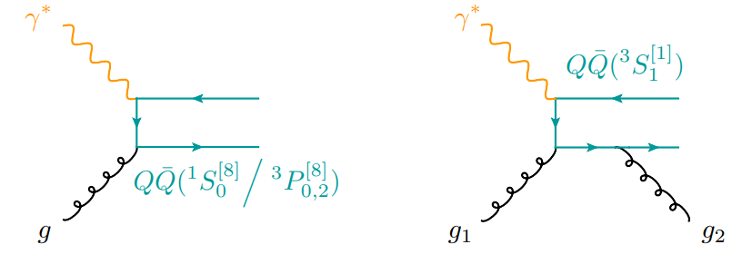
Direct Production Mechanisms
The electron can also “strike” a gluon in the proton. This process competes with fragmentation.
There are two ways can be produced through photon gluon fusion.
can either be in a color singlet or a color octet.
Color octet is leading order in
Color singlet is leading order in “v”.
Use collinear factorization.

Slide 32
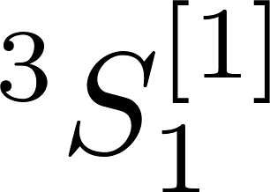
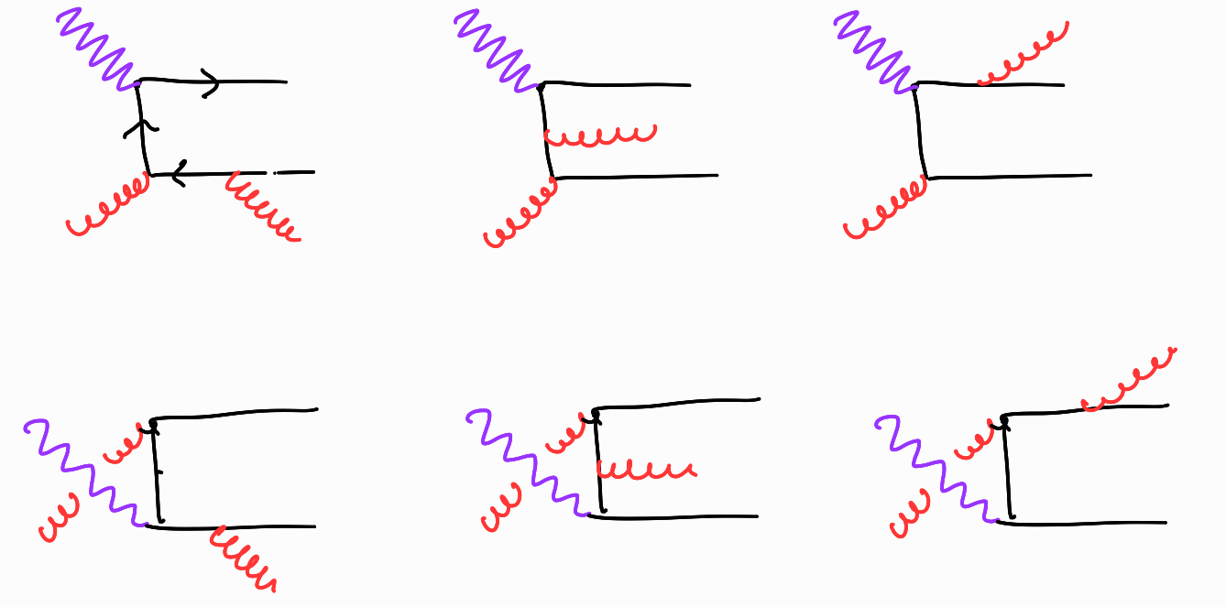
Color Singlet Photon-Gluon Fusion
6 diagrams – is in the state.
Expected to contribute more for z < 1.
Radiated gluon steals momentum from the initial parton.

Slide 33
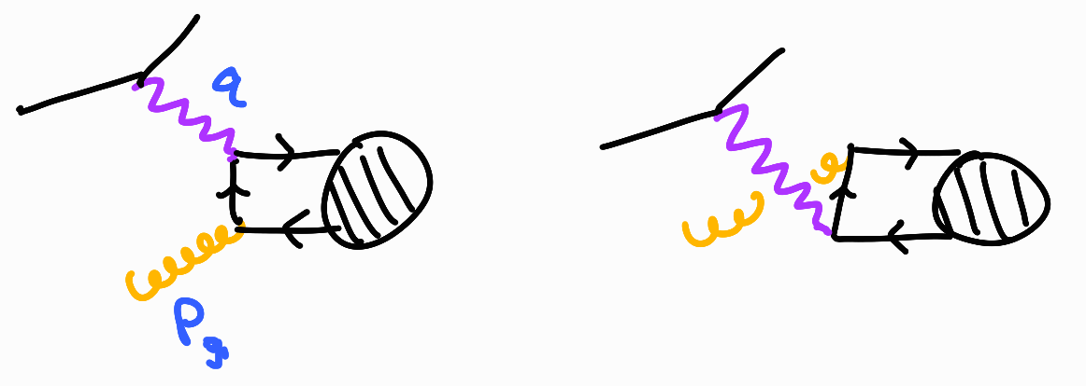
Color Octet Photon-Gluon Fusion
is either in or since there is no additional gluon to make it a color singlet.
No gluon is radiated so the takes carries away all of the initial parton momentum.
This process dominates as z -> 1.

Slide 34
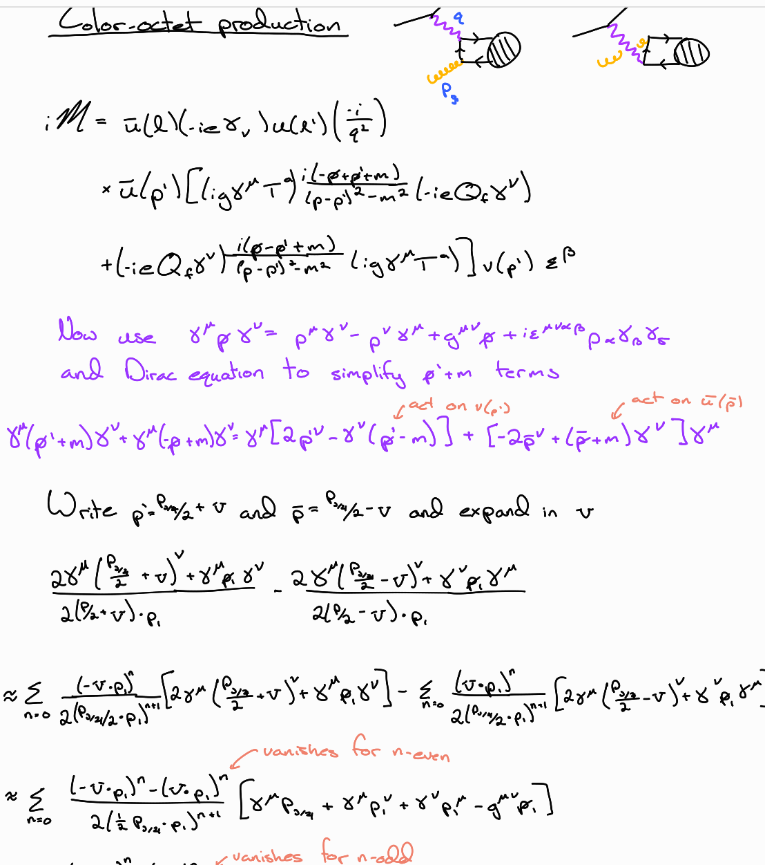
Color Octet Photon-Gluon Fusion
is either in or since there is no additional gluon to make it a color singlet.
No gluon is radiated so the takes carries away all of the initial parton momentum.
This process dominates as z -> 1.

Slide 35
Comparing production mechanisms

Slide 36
Gluon to Polarizations
Can also generalize to other polarizations.
Gluon parton can be unpolarized, vector polarized, or tensor polarized.
To determine what’s possible, first plug in polarizations.
Then make a tensor decomposition of cross section by writing down all objects that are Hermitian, even under parity, and independent of/linear in spin.

Slide 37
Gluon Fragmentation (Leading Order)
TMD Gluon to J/Psi FF has not been studied in literature.
Does not show up at leading twist in SIDIS, but is relevant for quarkonium production in jets.
Definition of FF is different, however procedure for calculation is similar.

Slide 38
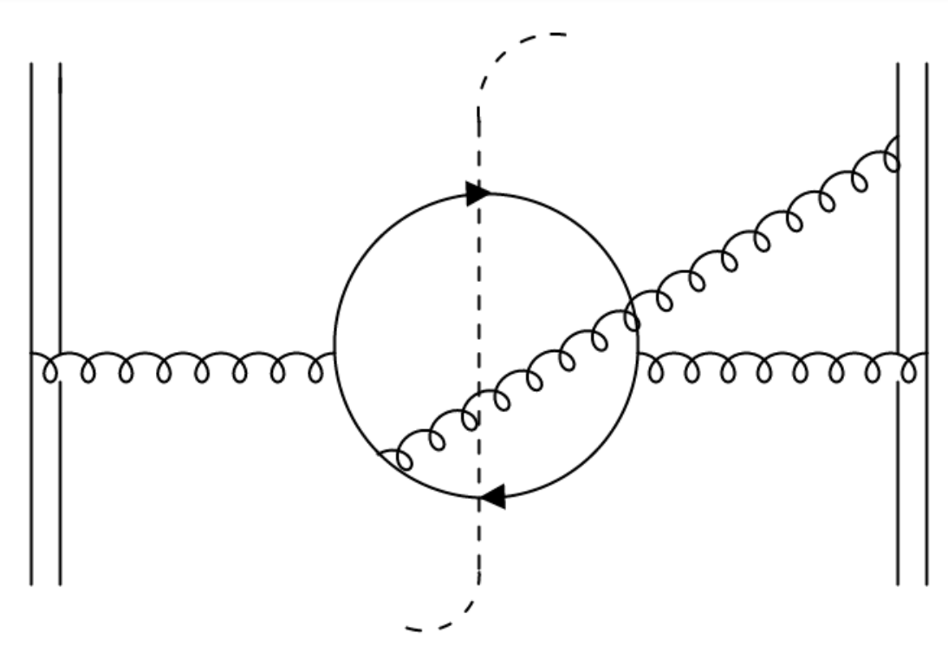
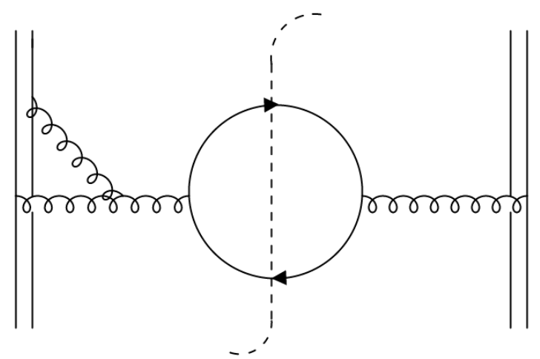
Next to Leading Order
NLO quickly becomes more challenging.
21 unique “emission diagrams” and 19 loop corrections for LO (plus mirrors).
Now have tricky rapidity divergences as z 1 in addition to ultraviolet and infrared divergences.

Slide 39
Next to Leading Order
NLO quickly becomes more challenging.
21 unique “emission diagrams” and 19 loop corrections for LO (plus mirrors).
Now have tricky rapidity divergences as z 1 in addition to ultraviolet and infrared divergences.
IN PROGRESS

Slide 40
Future Work
Finish identifying which regions of phase space the different production mechanisms dominate.
Extend direct production to TMD factorization framework.
More phenomenological studies (beam asymmetries, identify other interesting observables, etc.)
Finish gluon fragmentation NLO work and study quarkonium production in jets.
Calculate TMD fragmentation functions for other hadrons
Other quarkonia
Kaon and pion.
Compare with experimental predictions.

