Slide 1
Dr. Ji Group Meeting 4/19 Slides
Hunter Duggin

Slide 2
Background
HPDVideography
PER under Dr. Katie Mack at NCSU
Video Abstracts
Research under Dr. Ji

Slide 3
Interpolating the ’t Hooft Model Between IFD and LFD in the Coulomb Gauge
Hunter Duggin, Chueng-Ryong Ji, Bailing Ma
Funded by Provost Professional Experience Program

Slide 4
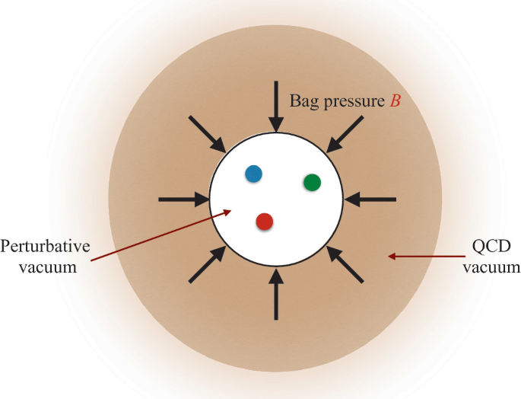
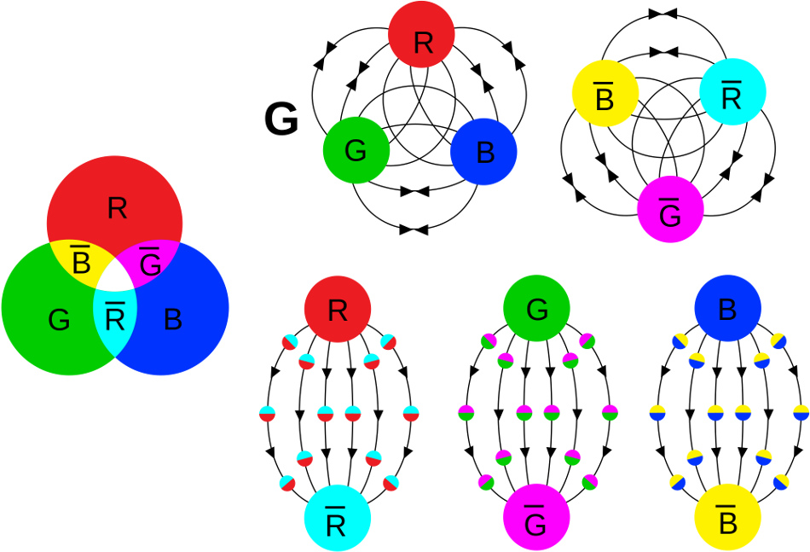
Quark Model in QCD
Baryons
Mesons
[1] MIT Bag Model
[2] QCD Illustration
Baryons are an N_{c} valence quark bound state
Mesons are valence quark-antiquark bound states
Running coupling constant

Slide 5
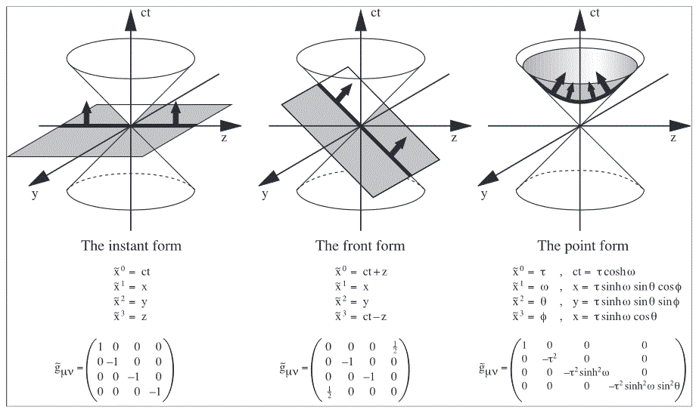
Light Front Dynamics
[3] Illustration of Dirac’s proposed coordinates

Slide 6
Interpolation between Instant and Front Form
IFD
LFD

Slide 7
Interpolation between Instant and Front Form
IFD
LFD

Slide 8
‘t Hooft’s Meson Model
(1+1) Model
Large Nc limit
Predicts color confinement
Coupling constant has mass dimension
Notes:
Planar diagrams can be reduced to self-energy ladder diagrams

Slide 9
Motivation
To establish a formal link between IFD and LFD
Not the same as Lorentz transformation (equal time)
Simplify calculations ordinarily too difficult to solve in IFD
Explore an alternative quasi-PDF implementable in Lattice QCD (Bailing)
Notes:
Maximum number of Poincare symmetries
NOT Lorentz transformations
Spacetime Coordinate Transformation image discuss trace and time degrees of freedom being equal in front form

Slide 10
Why Coulomb Gauge?
*In IFD 1+1
:= Coulomb Gauge
{
OR
:= Axial Gauge
Lorentz Condition
Axial gauge calculations have already been done [2]
Consistent with QED
All degrees of freedom are physical
Proposed resolution to the QCD (1+1) Conjugate Field Problem

Slide 11
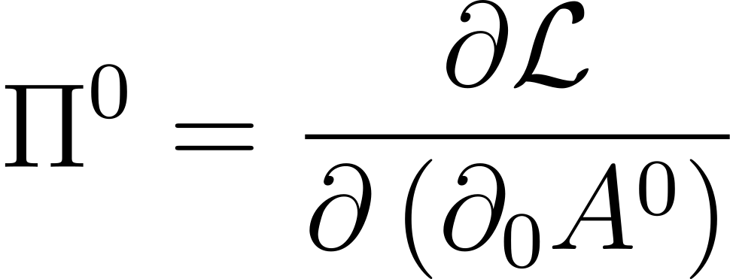
Conjugate Field
Pi-0 field as an operator can generate and annihilate particles
In the Coulomb gauge, the Pi-0 field does not exist
The “color electric field” still appears as a constraint of the equation of motion in the Coulomb gauge (analogous to Gauss’s law in QED).

Slide 12
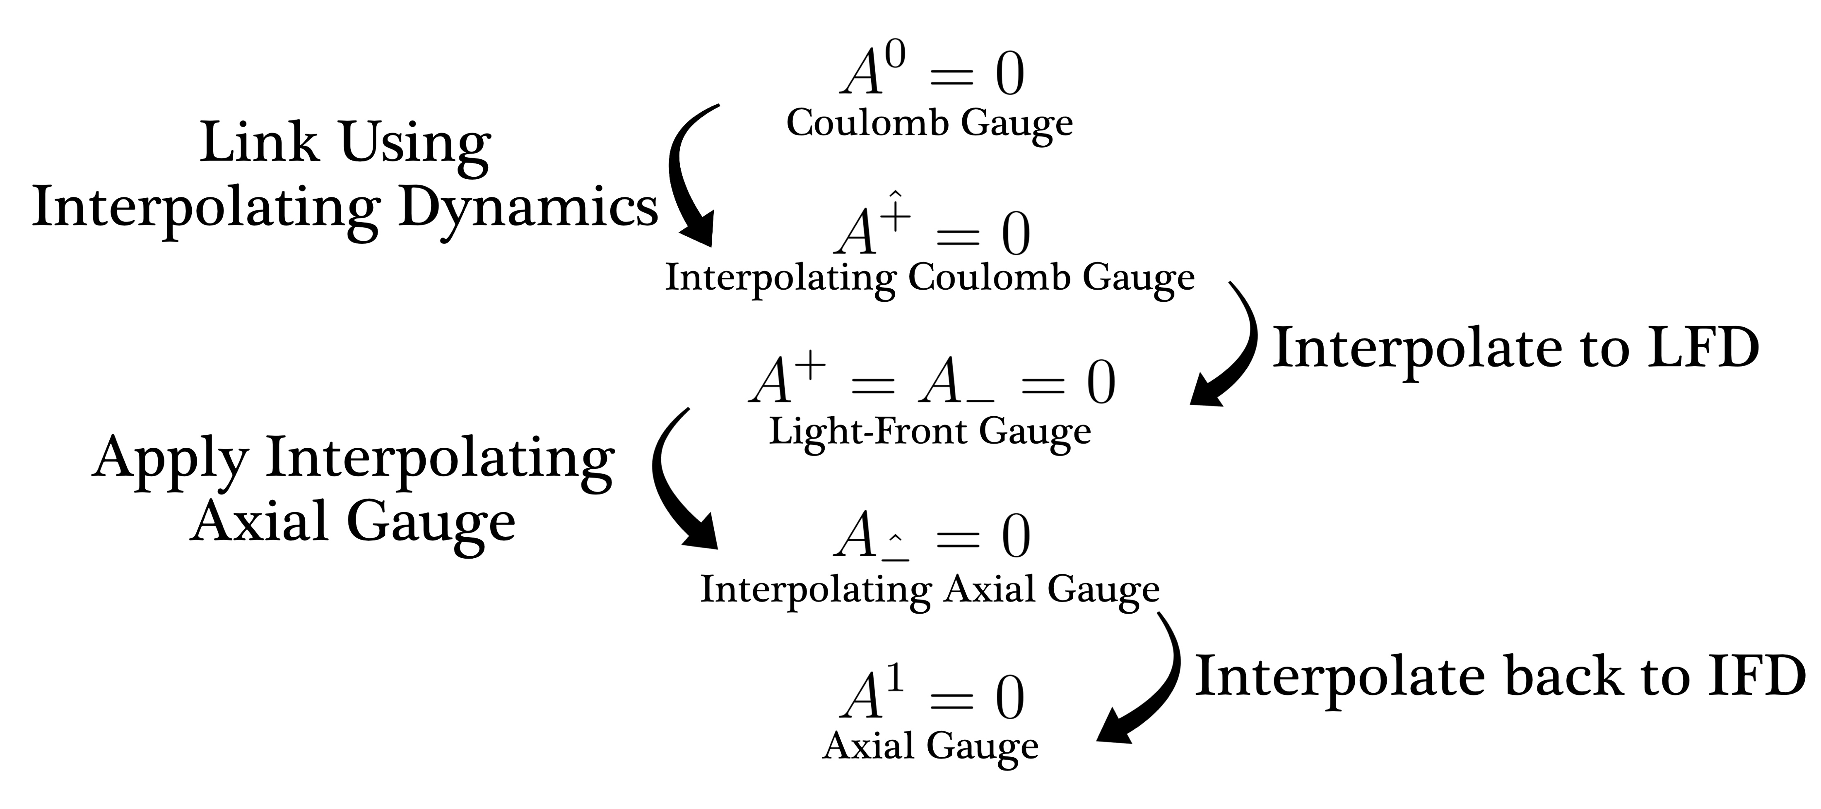

Slide 13
Comparison of Axial and Coulomb Gauge
Lagrangian
Axial Gauge:
Coulomb Gauge:
Notes:
\mathcal{L} = \frac{1}{2}\left(\partial_{\hat{+}}A^{a}_{\hat{-}}\right)^{2} + \bar{\psi}\left[i\gamma^{\hat{-}}D_{\hat{-}}+i\gamma^{\hat{+}}\partial_{\hat{+}}-m\right]\psi

Slide 14
Comparison of Axial and Coulomb Gauge
Axial Gauge:
Coulomb Gauge:
The field equation is dependent on the interpolating space dimension.
The source of the potential is explained by an effective charge density, which acts like a background field.
The field equation is dependent on the interpolating time dimension.
The source of the potential is explained by an effective current density, which acts like a globally changing field through time.
Notes:
Partial mu partial mu a nu = j nu d^2phi = rho

Slide 15
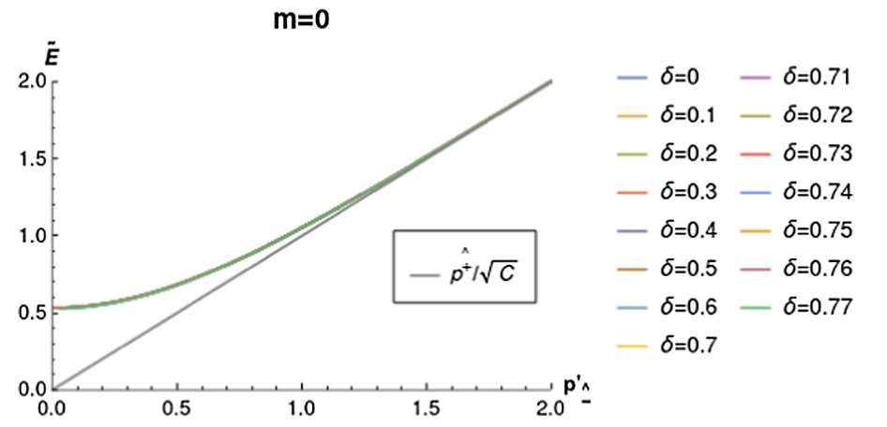
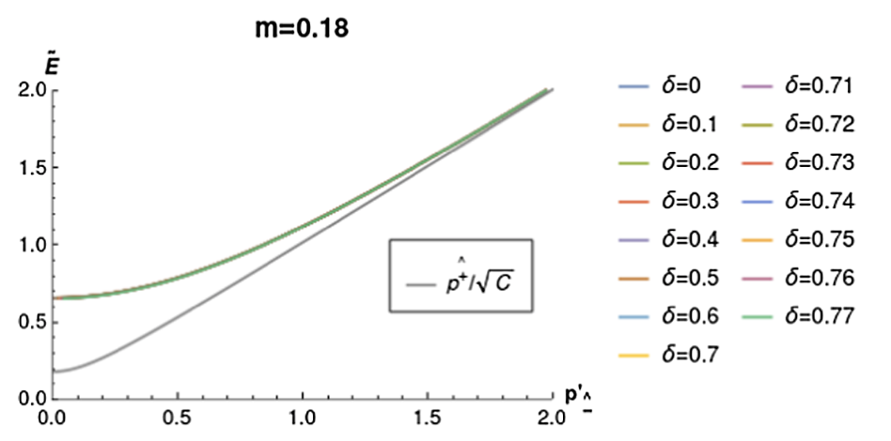
Mass Gap Solution
Note: This is independent of the interpolation angle

Slide 16
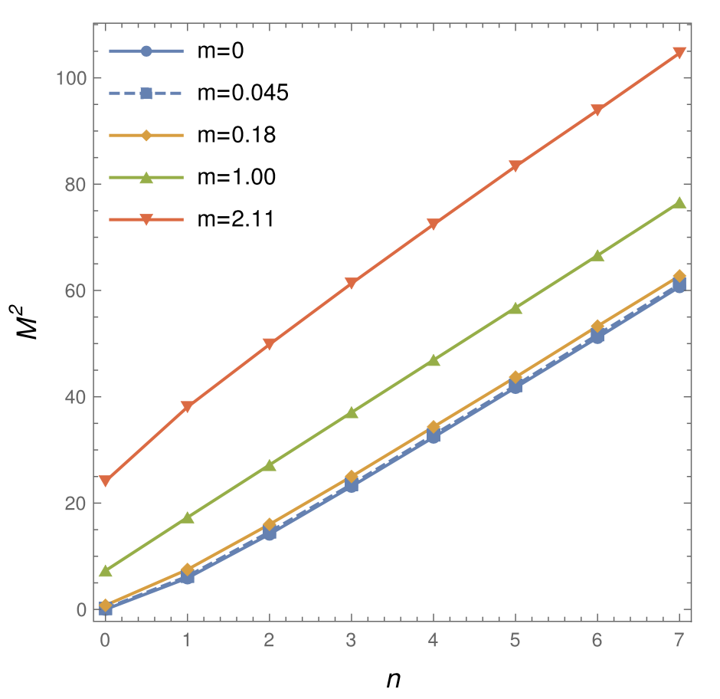
Bound State Mass Spectra and Regge Behavior
Mass increases (roughly) linearly with principal quantum number
Notes:
Gellmann oaks renner relation

Slide 17
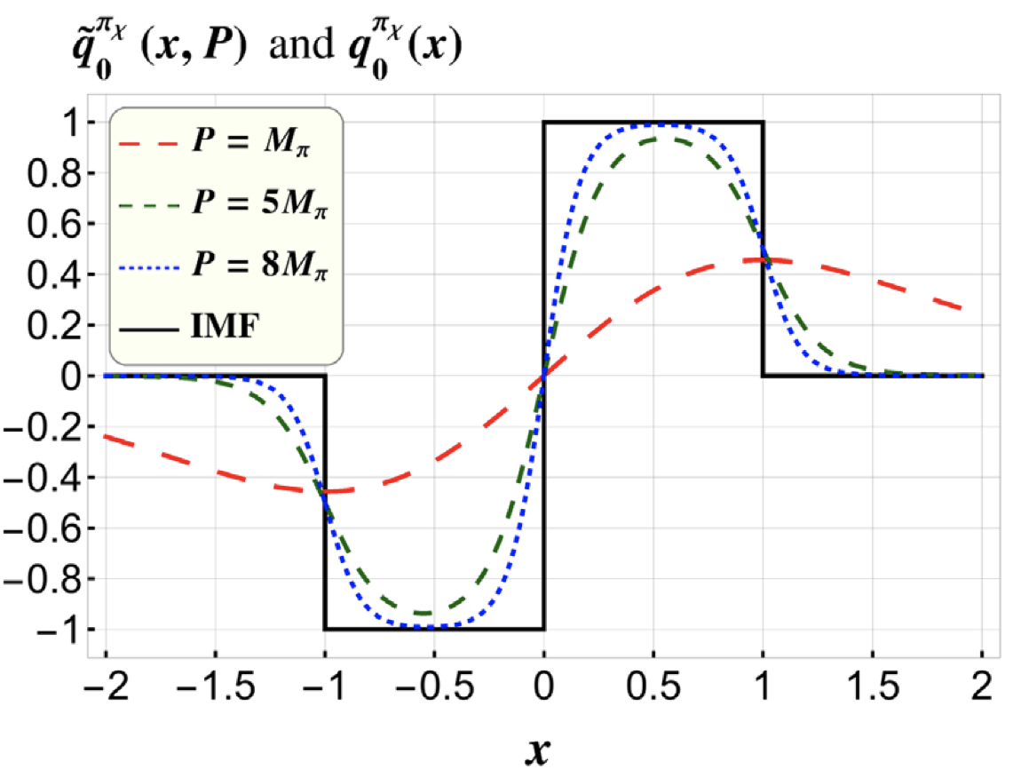
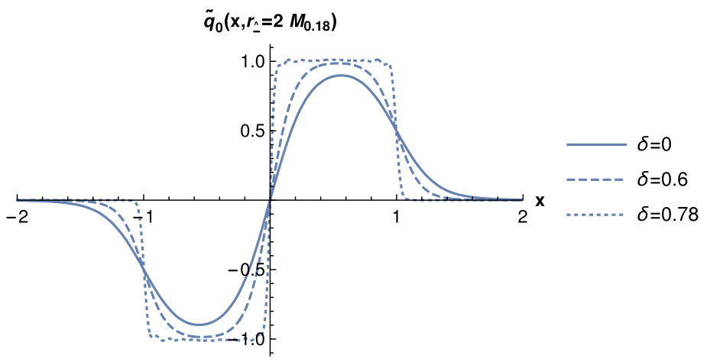
Application: Alternative Quasi-PDFs
= 0.41
= 1.76
= 2.05
= 3.28
LFD
= 0.9931 * $\frac{π}{4}$
Jia, Y., Liang, S., Xiong, X., & Yu, R. (2018). ARXIV.1804.04644
Dependent on Interpolation angle and momentum
Does not suffer from the large momentum boost

Slide 18
Conclusion and Future Work
Conclusion:
The ‘t Hooft model is interpolated between the instant form and the front form in the axial gauge, looking to explore the Coulomb gauge
Interpolating dynamics is used to help resolve conjugate field operator issue in the axial gauge.
The mass gap equation is solved and plotted
The mass spectra shows Regge behavior, which we see in nature
Bound state wave functions are used to calculate alternative quasi-PDFs
Future work:
(3+1) and Nc = 3 needs to be explored
Testing the alternative quasi-PDF on the lattice
Exploring the time-like region using LFD

Slide 19
Presentations / Publications
Poster talk at SPIN 2023 (Duke University)
Oral presentation at DNP / JPS Hawaii
Accepted for publication of conference proceedings paper (PoS(SPIN2023)051) on March 29
APS April meeting 2024 Sacramento
NCUR 2024 Long Beach

Slide 20
Bibliography
Ma, B., & Ji, C.-R. (2021). Interpolating ’t Hooft model between instant and front forms. In Physical Review D (Vol. 104, Issue 3). American Physical Society (APS). https://doi.org/10.1103/physrevd.104.036004
Zwanziger, D. (1998). Coulomb-Gauge in QCD: Renormalization and confinement. Progress of Theoretical Physics Supplement, 131, 233-242. https://doi.org/10.1143/ptps.131.233
Hoyer, P. (2021). Journey to the Bound States. arXiv. https://doi.org/10.48550/ARXIV.2101.06721
Jia, Y., Liang, S., Xiong, X., & Yu, R. (2018). Partonic quasidistributions in two-dimensional QCD. arXiv. https://doi.org/10.48550/ARXIV.1804.04644
Images:
[1] Hoyer, P. (2021). Journey to the Bound States. arXiv. https://doi.org/10.48550/ARXIV.2101.06721
[2] https://webific.ific.uv.es/web/en/content/lattice-qcd-numerical-approach-strong-force
[3] https://ncatlab.org/nlab/show/light-cone+quantization
[Else] Ma, B., & Ji, C.-R. (2021). Interpolating ’t Hooft model between instant and front forms. In Physical Review D (Vol. 104, Issue 3). American Physical Society (APS). https://doi.org/10.1103/physrevd.104.036004

Slide 21
Future Directions
PhD at UNC!
Dr. Amy Nicholson

