Slide 1
Nonlocal QED and nonlocal EFT
Ping Wang
Institute of high energy physics, CAS

Slide 2
Nonlocal QED and lepton g-2 anomalies,
H. Li and P. Wang, Eur. Phys. J. C 84 (2024) 7, 654
Solution of lepton g − 2 anomalies with nonlocal QED,
H. Li and P. Wang, J. Phys. G 50 (2023) 11, 115001
Nonlocal chiral contributions to generalized parton distributions of the proton at nonzero skewness,
Z. Y. Gao, F. C. He, C. R. Ji, W. Melnitchouk, Y. Salamu and P. Wang, Phys. Rev. D (2024)
Nucleon gravitational form factors,
Y. Salamu, F. C. He, C. R. Ji, W. Melnitchouk and P. Wang (In preparation)

Slide 3
Nonlocal behavior is general for all the interactions?
Nonlocal EFT (Nucleon structure, FFs, PDFs)
Nonlocal QED (lepton g-2)， Nonlocal Gravity (Gravitational FFs)

Slide 5
photon propagator:
n = 2, 3, 4

Slide 8
Solution of lepton g − 2 anomalies with nonlocal QED,
H. Li and P. Wang, J. Phys. G 50 (2023) 11, 115001

Slide 20
… …

Slide 21


$$F_{1}(p^{′}−k)F_{1}(p−k)$$
$$F_{1}(p^{′}−k)F_{1}(p−k)$$

Slide 22
Nonlocal QED and lepton g-2 anomalies,
H. Li and P. Wang, Eur. Phys. J. C 84 (2024) 7, 654

Slide 23

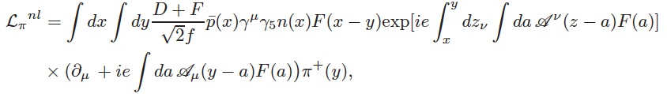

Nonlocal EFT
Local interaction including pi meson
Corresponding nonlocal Lagrangian
Local EM interaction
Corresponding nonlocal EM interaction
EM currents with pi meson:

Slide 24

Nonlocal EFT
The Lagrangian is gauge invariant under the following transformation:

Slide 25
Nonlocal EFT

Slide 26
Parton Distributions Functions
Match quark operator
to hadron operator:

Slide 27
Nonzero skewness GPDs:

Slide 33
Nonlocal chiral contributions to generalized parton distributions of the proton at nonzero skewness,
Z. Y. Gao, F. C. He, C. R. Ji, W. Melnitchouk, Y. Salamu and P. Wang, Phys. Rev. D (2024)

Slide 34
Nonlocal chiral contributions to generalized parton distributions of the proton at nonzero skewness,
Z. Y. Gao, F. C. He, C. R. Ji, W. Melnitchouk, Y. Salamu and P. Wang, Phys. Rev. D (2024)

Slide 35
Gravitational Form Factors

Slide 37
How to calculate the gravitational form factors with nonlocal interaction?
Electromagnetic interaction: local U(1) symmetry
Gravitational Interaction:
Local translation invariance
Local translation:
To cancel the second line:
Transformation of h:

Slide 38
Leading order:
Next-to leading order:

Slide 39
Belinfante-Rosenfeld EM tensor:
Invariance under the symmetric and traceless transformation:

Slide 40
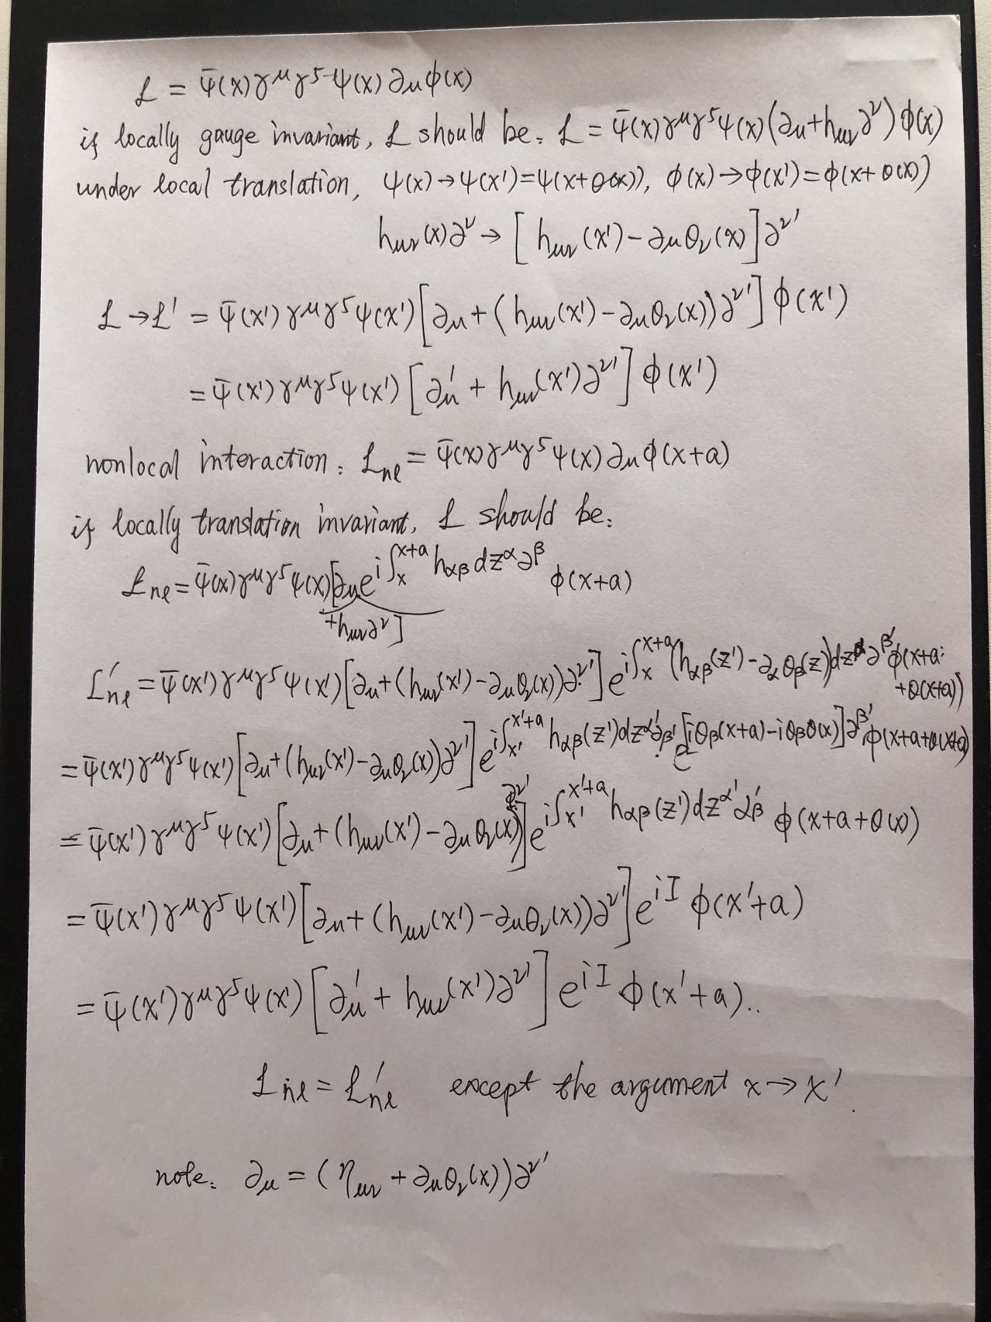

Slide 42
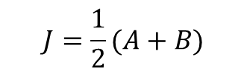
$$J=\frac{1}{2}(A+B)$$

Slide 43
The End

