Slide 1
Nonlocal EFT, nonlocal QED and nonlocal gravity
Ping Wang
Institute of high energy physics

Slide 2
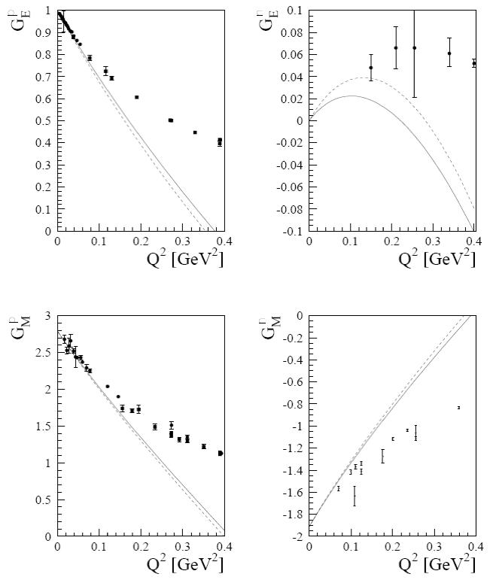
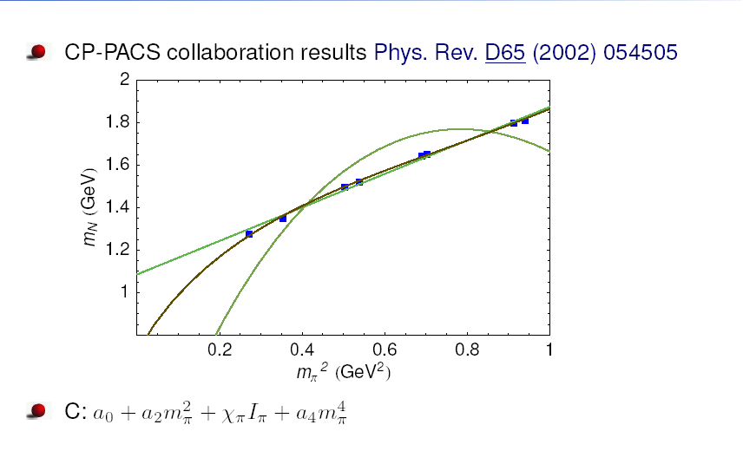
why nonlocal ?
More realistic:
Natural way to deal with UV divergence
Better to describe experimental data
Hadron structure, lepton g-2
T. Fuchs, J. Gegelia, S. Scherer, J. Phys. G30 (2004) 1407

Slide 3
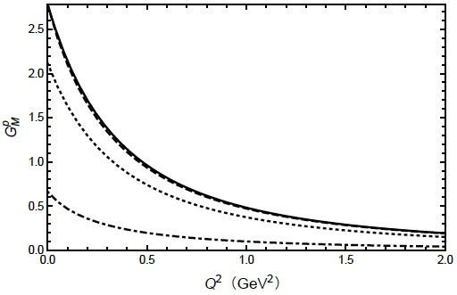
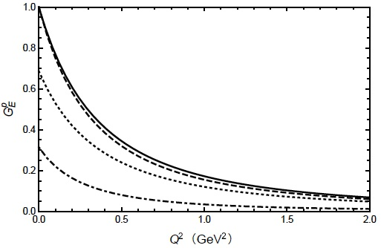
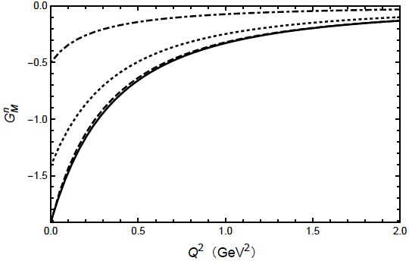
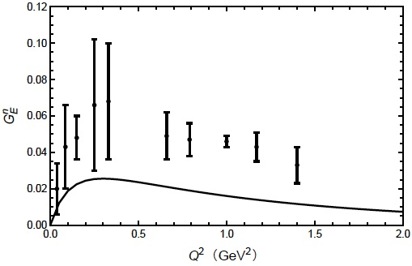
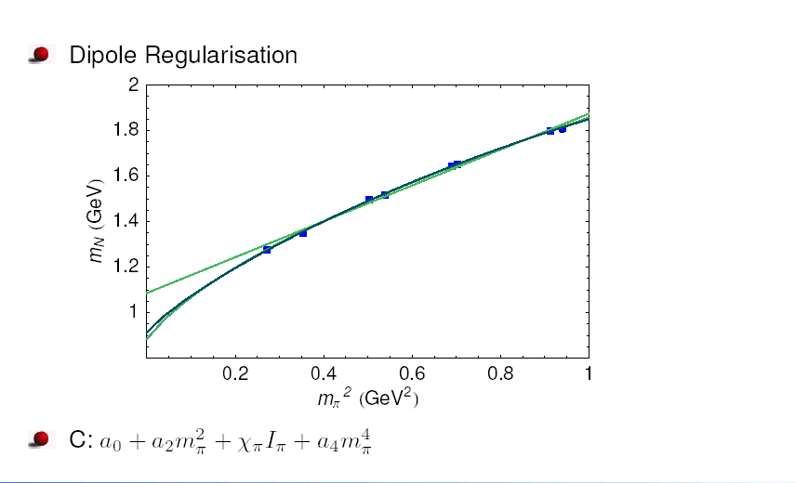

Slide 4
Nonlocal Lagrangian
Motivation:
Finite-range-regularisation
Relativistic regulator
Heavy baryon EFT Covariant EFT
Gauge symmetry distroyed Gauge symmetry restored
Ward identity, Charge conservation, Renormalised nucleon charge
Gauge invariant renormalization method
Solution:
Gauge invariant nonlocal Lagrangian
Regulator derived from the Lagrangian
Make it possible to study hadron structure at relatively large Q^2
FFs, PDFs, GPDs, TMDs, … …

Slide 5
Nonlocal: Lorentz invariance, Unitarity, Causality
Lagrangian is relativistic and Hermitian.
∫ Ψ(x) Ψ(x) A(x+a) F(a) da = ∫ φ(x) A(x+a) F(a) da
φ(x) = ∫ 𝜙(x+b) G(b) db The particle is not a point one.
∫ φ(x) A(x+a) F(a) da = ∫ ∫𝜙(x+b) A(x+a) F(a) G(b) da db
= ∫ ∫𝜙(y) A(y+a-b) F(a) G(b) da db
= ∫ ∫𝜙(y) A(y+a’) F(a’+b’) G(a’-b’) da’ db’
∫ F(a’+b’) G(a’-b’) db’ = delta (a’)
∫ F(p) G(q) exp[b’(p-q)] exp[a’(p+q)] db’ dp dq = ∫ F(p) G(p) exp[2a’p]dp = delta(a’)
F(p) G(p) = 1

Slide 6

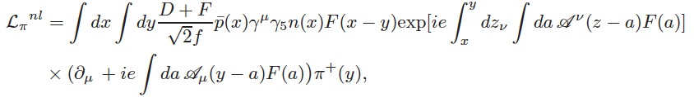

Local interaction including pi meson
Corresponding nonlocal Lagrangian
Local EM interaction
Corresponding nonlocal EM interaction
EM currents with pi meson:

Slide 7

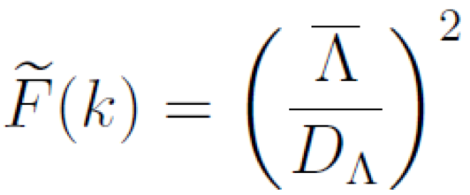
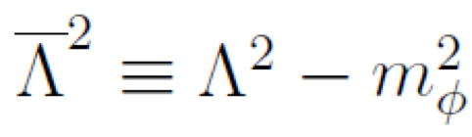
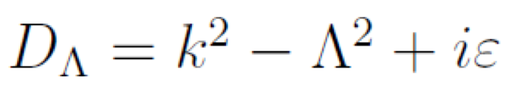
The Lagrangian is gauge invariant under the following transformation:
Parameters:
= 1
c1 , c2 are determined by the proton and neutron magnetic moments 2.79 and -1.91.
Parameters in traditional ChPT: c1, c2, c3, c4, c5, c6

Slide 8
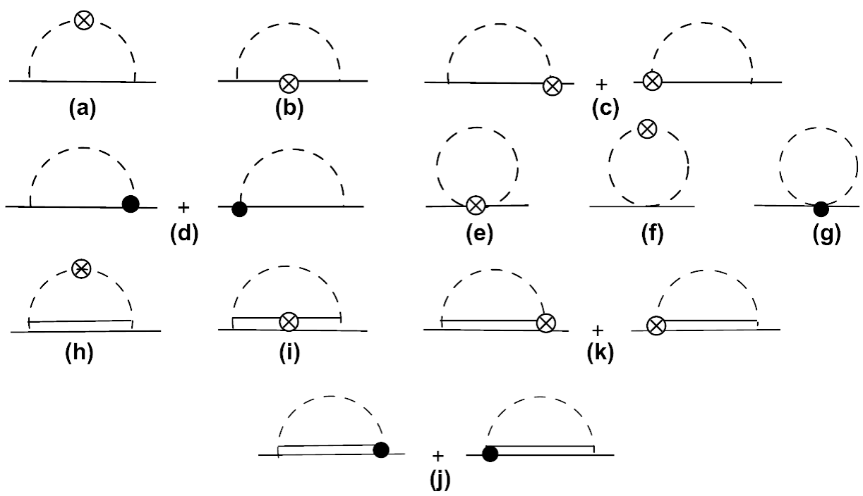
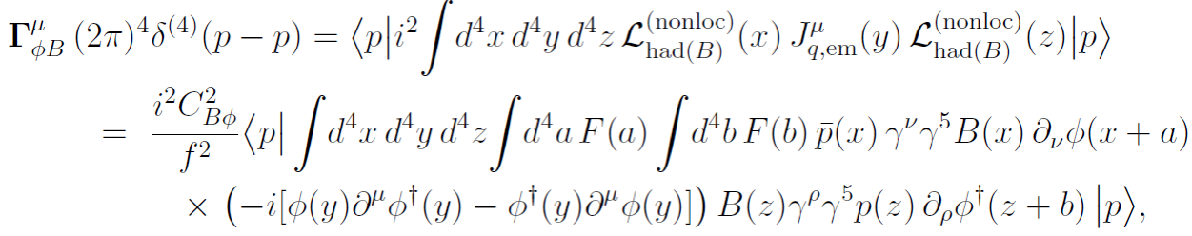
Parton distribution functions
Splitting functions
One loop diagrams:

Slide 9
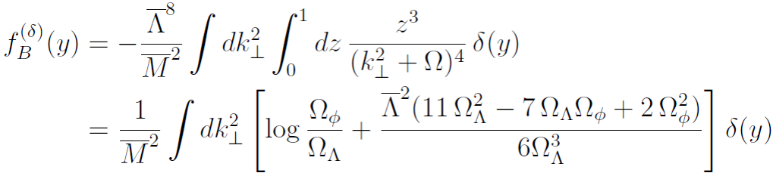
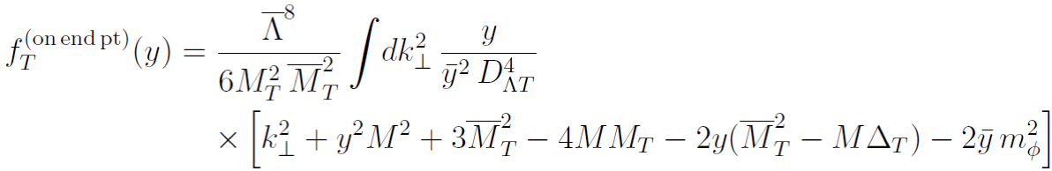
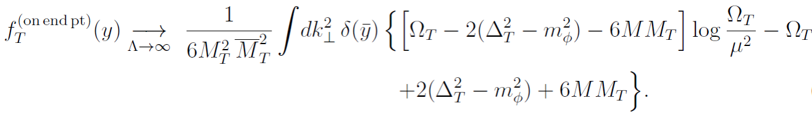
Delta function terms:
End-point term:
Local limit:

Slide 10
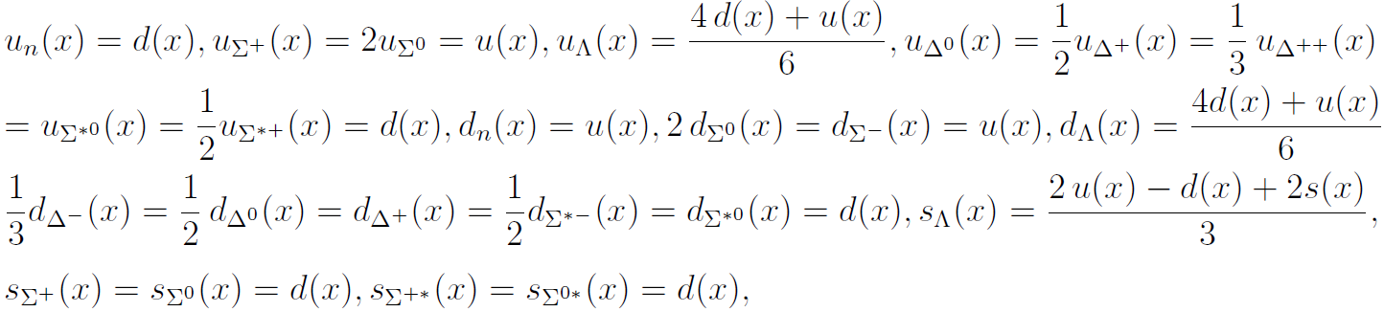
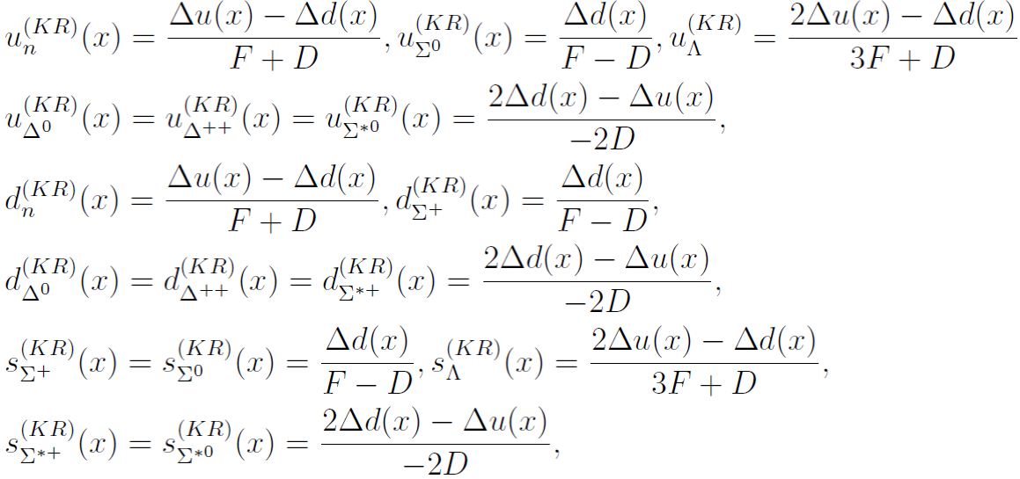
Input PDFs of valence at tree level:
valence quark
in mesons:
valence quark
in baryons:
quark distributions
For KR diagrams:

Slide 12
Convolution form
In the forward limit

Slide 15
Nonlocal behavior is general for all the interactions?

Slide 21





Second quantization, Canonical quantization

Slide 22
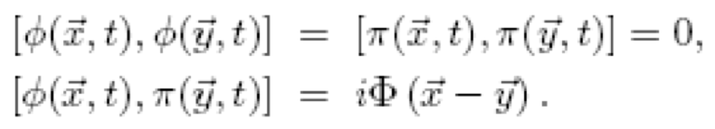
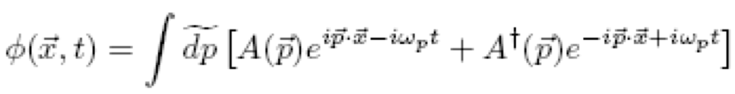
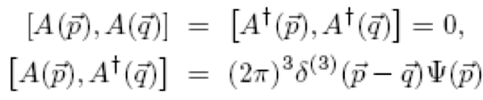
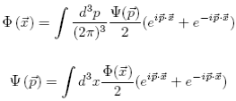
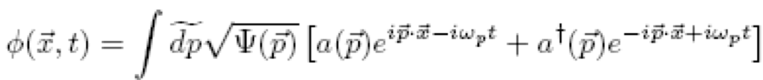
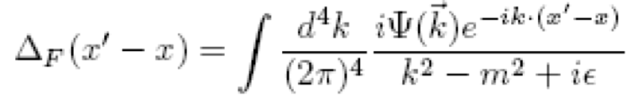
Solid quantization

Slide 23

Relativistic case
Point particle
Pauli-Villars

Slide 24
Gravitational Form Factors

Slide 25
How to calculate the gravitational form factors with nonlocal interaction?
Electromagnetic interaction: local U(1) symmetry
Gravitational Interaction:
Local translation invarance
Local translation:
To cancel the second line:
Transformation of h:

Slide 26
Leading order:
Next-to leading order:
Belinfante-Rosenfeld EM tensor:
Invariance under the symmetric and traceless transformation:

Slide 27
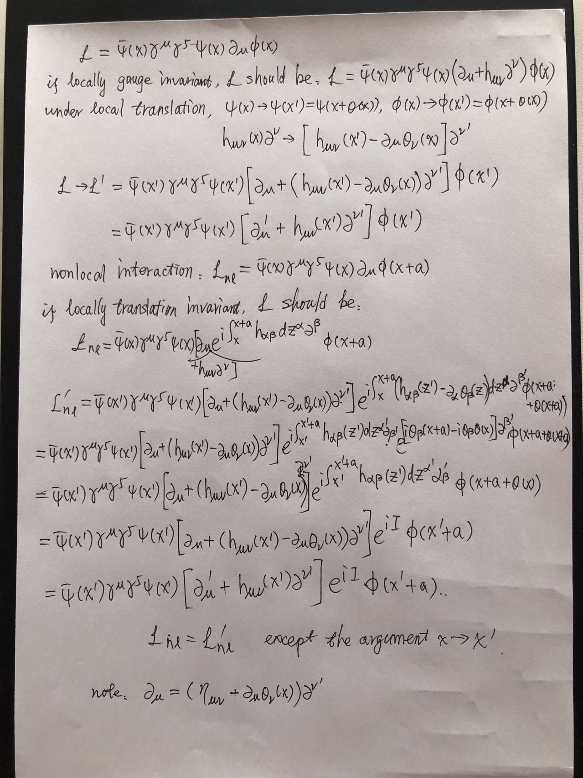

Slide 29
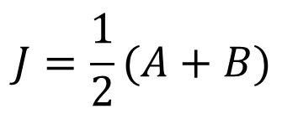
$$J=\frac{1}{2}(A+B)$$

Slide 30
The End !

